Slide 1
Information Flows
Channels - mechanisms for signalling information
Explicit Flows:
X:=Y – Y flows to X
Covert Channels - primary purpose is not information transfer
Implicit Flow:
h:= h mod 2;
l:=0;
if h=1 then l:=1
else skip
Does not leak the exact value of i to l , but it does leak some information about the value of h to l
Someone observing lo could tell whether hi is negative or not.

Slide 2
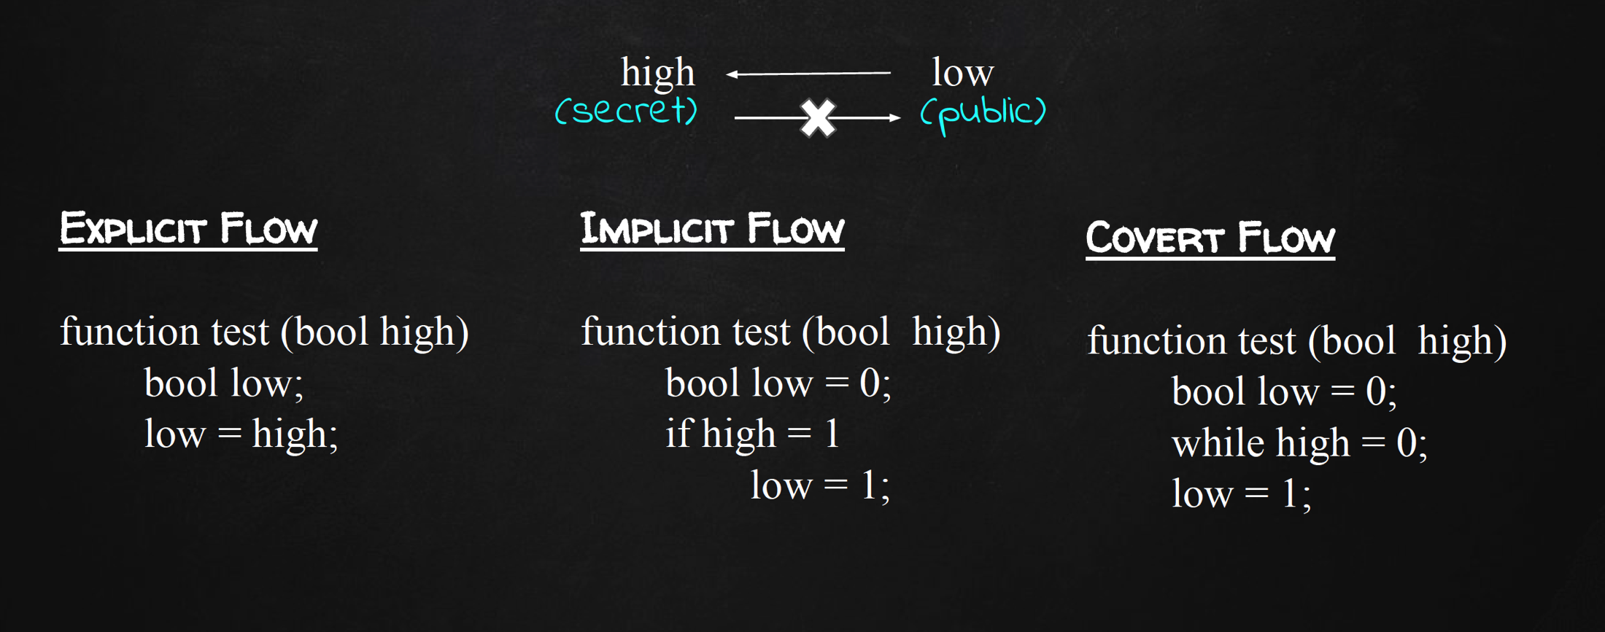

Slide 3
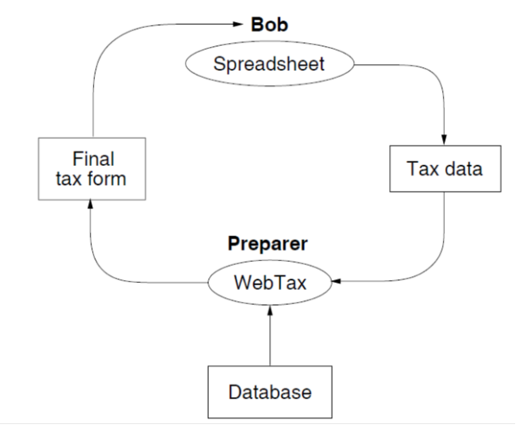
Confidentiality Example
Principal Preparer – distributor of WebTax-may have privacy interests
WebTax application computes the final tax form using a proprietary database, shown at the bottom (owned by Preparer).
this might, contain secret algorithms for minimizing tax payments.
Since this principal is the source of the WebTax software, it trusts the program not to distribute the proprietary database through malicious action,
However, the program might leak information because it contains bugs.

Slide 4
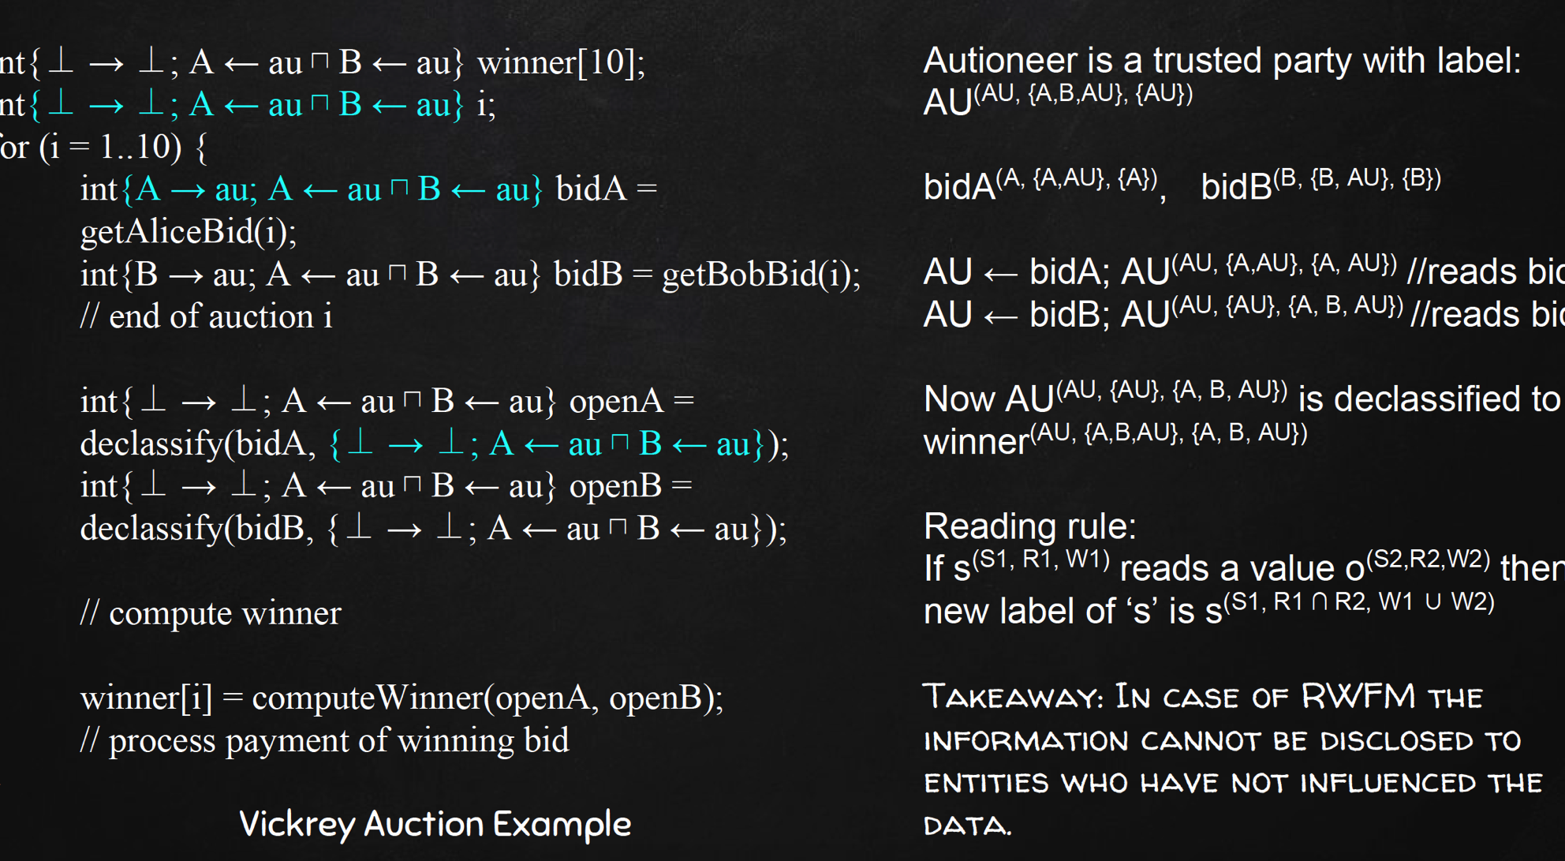
Vickery Auction

Slide 5
Enforcing data security policy while executing untrusted code
Lightly Shaded – Confidential
Unshaded – non-confidential
Dark Shaded – Special privileges
to relay the scanner’s confidential
output to the terminal.
Circles: Processes
Rectangles: Files/Dir
Rounded Rect: Devices

Slide 6
Conference Systems
Lambda–Chair
EasyChair
HotCRP

Slide 7
State of the Art
Centralized labels – Denning (1975)
Decentralized Model – Myers and Liskov ( 1997)
Robust Declassification ( 2004)
Flume (2007), Laminar(2012), Histar OS(2006)

Slide 8
Decentralized Label Model Myers and Liskov (2000)
addresses the weaknesses of earlier approaches to the protection of confidentiality in a system containing untrusted code or users, even in situations of mutual distrust
allows users to control the flow of their information without imposing the rigid constraints of a traditional MLS
defines a set of rules that programs must follow in order to avoid leaks of private information
protects confidentiality for users and groups rather than for a monolithic organization
introduces a richer notion of declassification
in the earlier models it was done by a trusted subject; in this model principals can declassify their own data

Slide 9
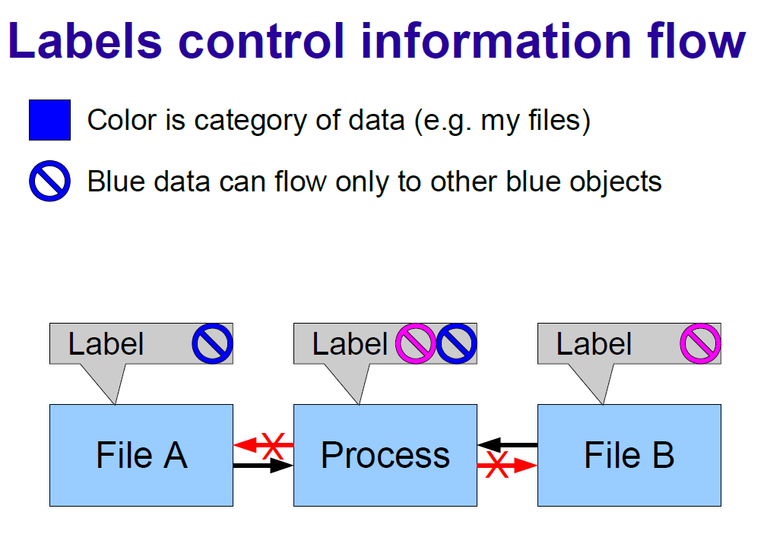

Slide 10
Drawbacks of State-of-the-art
1985 Trusted Computer Systems Evaluation Criteria (Orange Book)
defines the security of a computer system by how well it implements flow control and how good its assurance is
Despite huge efforts, systems developed had several drawbacks:
large TCB, slow, not easy to use, and very limited functionality

Slide 11
Drawbacks of State-of-the-art
2000 Myers & Liskov (DLM) and robust declassification ( 2004
only readers for protecting confidentiality and only writers for protecting integrity
Essentially becomes DAC due to free Declassification
Flaw: for a proper tracking of any information flow property, it is important to control both reading and writing by subjects

Slide 12
Drawbacks of State-of-the-art
HiStar, Flume and Laminar systems
based on the product of Confidentiality and Integrity
Flaw: confidentiality and integrity are not orthogonal properties
The declassification rules essentially becomes discretionary
Fred Schneider, in his book# chapter, clearly brings out the perils of combining confidentiality and integrity policies in this manner
# yet to be published,
available at http://www.cs.cornell.edu/fbs/publications/chptr.MAC.pdf

Slide 13
Drawbacks of State-of-the-art
2012 Mitchell et al. (DC labels)
not easy to derive consistent DC labels for modelling a given requirement
Flaw: support for downgrading (discretionary control) is orthogonal to the IFC, thus, defeating the purpose of the mandatory controls

Slide 14
Drawbacks of State-of-the-art
2011 Butler Lampson in HiStar technical perspective
This is the latest step in the long and frustrating journey toward secure computing. It is a convincing solution for some serious practical problems. The general-purpose computing that failed in the 1980s has not been tried

Slide 15
RWFM Model
Narendra kumar, RKS 2014
Nv narendra Kumar, RKS, 2016

Slide 16
Readers-Writers Labels
Security requirements of practical applications are often stated / easily understood in terms of who can read / write information
Observations:
information readable by s₁ and s_{2,} can-flow-to information readable only by s₁
information writable only by s_{1,} can-flow-to information writable by s₁ and s₂
Readers and writers can be used as labels!!

Slide 17
RWFM Label Format
(owner/authority, readers, writers)
First component is a single subject denoting
owner in case of an object label
authority in case of a subject label
Second component is a set of subjects denoting
permissible readers in case of an object label
subjects who can read all the objects that this subject can read in case of a subject label
Third component is a set of subjects denoting
permissible writers in case of an object label
subjects who can write all the objects that this subject can write in case of a subject label

Slide 18
Permissible Flows in RWFM
Given any two RW classes RW₁=(s₁,R₁,W₁) and RW₂=(s₂,R₂,W₂), information is allowed to flow from RW₁ to RW₂, denoted RW₁≤RW₂ only if R₁ R₂ and W₁⊆W₂. Formally
R₁ R₂ | W₁⊆W₂
(s₁,R₁,W₁) ≤ (s₂,R₂,W₂)

Slide 19
Join and Meet of RW Classes
Let RW₁=(s₁,R₁,W₁) and RW₂=(s₂,R₂,W₂), be any two RW classes. Their join (⊕) and meet (⊗) are defined as follows:
(s₁,R₁,W₁) ⊕ (s₂,R₂,W₂) = (s₃,R₁∩R₂,W₁∪W₂)
(s₁,R₁,W₁) ⊗ (s₂,R₂,W₂) = (s₃,R₁∪R₂,W₁∩W₂)
Notes:
For permissible flows, and join and meet, the first component – administrative component – does not play a role.

Slide 20
RW Classes form a Bounded Pre-Lattice
Prop: The relation ≤ on RW classes is reflexive and transitive i.e., a pre-order
Theorem: The set of all RW classes SC_{RW}=S×2^{S}×2^{S}, together with the ordering ≤, join ⊕ and meet ⊗ form a bounded pre-lattice. For s∈S, (s,S,∅) denotes a minimum element and (s,∅,S) denotes a maximum element.

Slide 21
Readers-Writers Flow Model
Above theorem establishes the soundness of RW classes w.r.t. Denning’s model i.e., suitability of RW classes for studying information flow properties in a system
Readers-Writers Flow Model (RWFM) is defined as a six-tuple (S,O,SC_{RW},≤_{RW},⊕_{RW},⊗_{RW}), where S is the set of subjects and O is the set of objects in an information system, and SC_{RW}, ≤_{RW},⊕_{RW},⊗_{RW} are as defined previously
Notes:
Although Denning’s model requires a lattice for info. flow properties, when applied to a decentralized setting and for supporting DAC we can have equivalent labels in different domains, thereby losing the anti-symmetry property.
Therefore, we establish that RW classes form a sound basis for info. flow. Definition of RWFM is the soundness w.r.t. Denning.

Slide 22
Notation
Flow model together with a labelling function defines an access policy
Labelling function λ : S∪O → SC_{RW}
A_{λ}(e), R_{λ}(e) and W_{λ}(e) denote the first, second and third components of λ(e)
λ is omitted when clear from the context
For a subject s, A(s)=s
Notes:
λ is the labelling function, and A, R and W are projection functions that return the first, second and the third components of the labels.
For a subject, we require that it execute with its authority i.e., A(s)=s.

Slide 23
Access Rules in RWFM
Given a RWFM and functions A, R and W describing a labelling,
A subject s is allowed to read an object o if
A(s)∈R(o) and R(o) R(s) and W(o) ⊆ W(s)
A subject s is allowed to write an object o if
A(s)∈W(o) and R(s) R(o) and W(s) ⊆ W(o)
DAC MAC DAC + MAC
Notes:
Note that, A(s)∈R(o) is a DAC check i.e. whether the subject is allowed to read or not, while R(o) >= R(s) and W(o) ⊆ W(s) is a MAC check on info. flow i.e. whether info is allowed to flow from object to subject or not. Similarly the write rule also is a combination of DAC with MAC.
These rules are a build-up to the completeness result.

Slide 24
Completeness of RWFM w.r.to Denning
Theorem: Given a Denning’s flow model DFM = (S,O,SC,≤,⊕) and a policy λ : S∪O → SC, there exists a labelling λ_{RW} : S∪O → SC_{RW}, in the RWFM that enforces the same policy i.e.,
s is permitted to read o by Denning’s policy if and only if it is permitted by RW-policy
s is permitted to write o by Denning’s policy if and only if it is permitted by RW-policy
Notes:
For every Denning’s policy there is an equivalent (in terms of permitted flows) RW policy.

Slide 25
Proof sketch
Proof is by construction
Labelling defined below in terms of the components A, R and W satisfies the conditions of the Theorem
A(o)=s’ | A(s)=s
R(o)={s | λ(o)≤λ(s)} | R(s)=S∩(∩_{λ(o)≤λ(s)}R(o))
W(o)={s | λ(s)≤λ(o)} | W(s)=S∩(∩_{λ(s)≤λ(o)}W(o))
Notes:
We actually construct the RW policy equivalent to a given Denning’s policy λ.
For objects
Administrative component can be any arbitrary subject, because as far as flows are concerned this does not play a role. So we set A(o) = s’ for all objects.
Readers component of a object is defined as R(o): the set of all subjects such that Denning’s policy permits info. flow from this object to subject.
Writers component of a object is defined as W(o): the set of all subjects such that Denning’s policy permits info. flow from subject to this object.
For subjects
Administrative component is the subject itself i.e. A(s) = s.
Readers component of a subject is defined as R(s): intersection of readers of all the objects (λ(o)≤λ(s)) that s can read.
Writers component of a subject is defined as W(s): intersection of writers of all the objects (λ(s)≤λ(o)) that s can write.

Slide 26
RW policy equivalent: Subjects
Administrative component can be any arbitrary subject, because as far as flows are concerned this does not play a role. So we set A(o) = s’ for all objects.
Readers component of a object is defined as R(o): the set of all subjects such that Denning’s policy permits info. flow from this object to subject.
Writers component of a object is defined as W(o): the set of all subjects such that Denning’s policy permits info. flow from subject to this object.

Slide 27
RW policy equivalent: Objects
Administrative component is the subject itself i.e. A(s) = s.
Readers component of a subject is defined as R(s): intersection of readers of all the objects (λ(o)≤λ(s)) that s can read.
Writers component of a subject is defined as W(s): intersection of writers of all the objects (λ(s)≤λ(o)) that s can write.

Slide 28
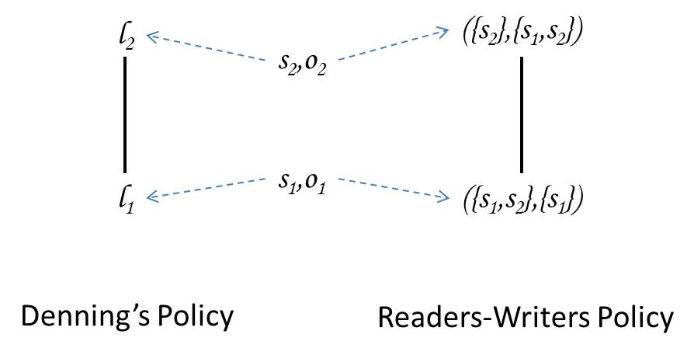
Illustrative Examples
Notes:
This is a basic example demonstrating how RWFM labels and policies are intuitive and simple.

Slide 29
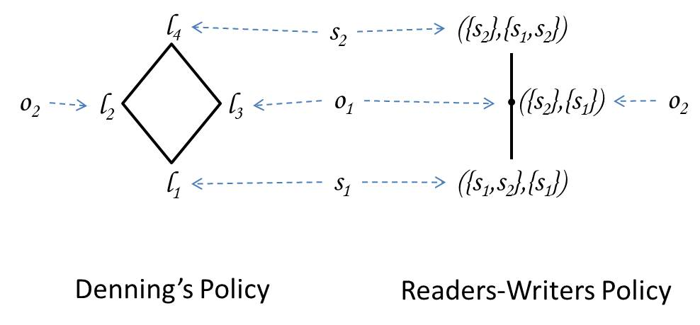
Illustrative Examples (contd)
Notes:
This example illustrates that RWFM policy is the most compact spec of a given policy i.e. it specifies the policy with the smallest set of labels. For example, in this example note that though objects o1 and o2 are labelled differently in Denning’s policy, as far as the subjects - whose actions actually lead to flow - are concerned these are equivalent. s1 can write both and read neither, and s2 can read both and write neither.
THEOREM: the maximum number of security classes needed in a system with n subjects is n*2^{2n}

Slide 30
State of an Information System
State of an information system is defined as the set of subjects and objects in the system together with their labels. Initial state
Objects and their labels as required for application
Each subject s starts with label (s,*,φ)
Whenever a subject tries to perform an operation on an object, it may lead to a state change and will have to be permitted only if deemed safe
Read
Write
Create
Downgrade
Relabel

Slide 31
State Transitions in RWFM
Subject s with label (s₁,R₁,W₁) requests read access to an object o with label (s₂,R₂,W₂)
If s₁∈R₂ then
relabel s to (s₁,R₁∩R₂,W₁∪W₂) and ALLOW access
Else
DENY access
POSSIBLE state change (label of s may change)
s has accessed information accessible only by common members of R₁ and R₂
s can read o
s is influenced by both W₁ and W₂

Slide 32
State Transitions in RWFM
Subject s with label (s₁,R₁,W₁) requests write access to an object o with label (s₂,R₂,W₂)
If s₁∈W₂ and R₁ R₂ and W₁⊆W₂ then
ALLOW access
Else
DENY access
NO state change
all subjects that can access information in o, can access information s has accessed so far
all subjects that have influenced the current information of s can also influence o
s can write o

Slide 33
State Transitions in RWFM
s, and all subjects that have influenced the current information of s have influenced o
all subjects that can access information accessed by s so far, can access o
Subject s with label (s,R,W) requests creation of an object o
create an object o and label it (s,R,W∪{s})
DEFINITE state change (a new object is added to the system)

Slide 34
State Transitions in RWFM
Subject s with label (s₁,R₁,W₁) requests an object o with label (s₂,R₂,W₂) to be downgraded to label (s₃,R₃,W₃)
If s₁∈R₂ and s₁=s₂=s₃ and W₁=W₂=W₃ and R₁=R₂ and R₃ R₂ and R₃-R₂⊆W₂ then
ALLOW
Else
DENY
POSSIBLE state change (label of o may change)
s, o and its downgraded version have been influenced by exactly the same set of subjects
subjects that can access o, can also access all the information s has accessed so far
subjects that could not access o but can access its downgraded version must have influenced information in o
downgrading does not impact ownership
s can read o
all the subjects that can access o can access its downgraded version also

Slide 35
State Transitions in RWFM
s, and all subjects that influenced the current information of s have influenced the relabelling
Subject s with label (s₁,R₁,W₁) requests an object o with label (s₂,R₂,W₂) to be relabelled with (s₃,R₃,W₃)
If s₁∈R₂ and s₁=s₂=s₃ and W₂⊆W₁ and W₃=W₁∪{s} and R₂ R₁ R₃ then
ALLOW
Else
DENY
POSSIBLE state change (label of o may change)
current information of s has been influenced by all the subjects that influenced o
relabelling does not impact ownership
all subjects that can access the relabelled object, could have accessed all the information that s has accessed so far, and the original object
s can read o

Slide 36
Downgrading (Declassifying)
For practical applications, adding readers (downgrading) to the result of a computation is essential for use by relevant parties
Downgrading rules
only the owner of information may downgrade it
if a single source is responsible for the information, then readers that can be added is unrestricted
if multiple sources influenced the information, then only those who influenced it may be added as readers

Slide 37
Reasoning about Information Flow between Objects in RWFM (1)
Theorem 1: Information in object o₁ with label (s₁,R₁,W₁) cannot flow to object o₂ with label (s₂,R₂,W₂) if any of the following conditions hold:
R₁=∅
W₂=∅
W₁ W₂
R₂ (R₁∪W₁∪W₂)
Notes:
This theorem gives the conditions under which information cannot flow between two objects with given labels:
If the first object cannot be read
If the second object cannot be written
First object influenced by someone who should not influence second object
Second object is readable by someone who can neither read the first object, nor has influenced the first or the second objects

Slide 38
Reasoning about Information Flow between Objects in RWFM (2)
Theorem 2: If R₂⊆R₁ and R₁∩W₂≠∅, and none of the conditions in Theorem 1 hold, only a subject in R₁ can make information to flow from o₁ to o₂.
Theorem 3: If R₂⊆(R₁∪W₁) and (R₁∪W₁)∩W₂≠∅, and none of the conditions in Theorems 1 and 2 hold, information can flow from o₁ to o₂ only as a result of a collusion between a subject in R₁ with a subject in W₁.
( help us identify the only possible culprits in the case of an info. flow.)
Notes:
Theorems 2, 3 and 4 are to be taken in a Forensics sense. These theorems help us identify the only possible culprits in the case of an info. flow.

Slide 39
Reasoning about Information Flow between Objects in RWFM (3)
Theorem 4: If none of the conditions in Theorems 1, 2 and 3 hold, information can flow from o₁ to o₂ only as a result of a collusion between a subject in R₁ with all the subjects in R₂∩W₂.

Slide 40
Information Flow between entities in RWFM
Theorem: Given a Denning’s flow model DFM = (S,O,SC,≤,⊕) with a policy λ : S∪O → SC, and the corresponding policy in the RWFM (constructed in the completeness theorem), the following holds: “information can flow from entity e₁ to entity e₂ under Denning’s policy if and only if it can flow without downgrading in the RW-policy”, where entity is either a subject or an object in the system.
Notes:
While the completeness theorem proved that “immediate info flows” (flows resulting due to a single operation by subjects) in a Denning’s policy can be simulated by the corresponding RW policy, this theorem says that all info flows (in single or multiple steps between not only a subject and an object, but between any two entities) in a Denning’s policy can be simulated in the RW policy modulo downgrading.

Slide 41
Informally
While the completeness theorem proved that “immediate info flows” (flows resulting due to a single operation by subjects) in a Denning’s policy can be simulated by the corresponding RW policy, this theorem says that all info flows (in single or multiple steps between not only a subject and an object, but between any two entities) in a Denning’s policy can be simulated in the RW policy modulo downgrading.

Slide 42
Access Rules in RWFM (recap..)
Given a RWFM and functions A, R and W describing a labelling,
A subject s is allowed to read an object o if
A(s)∈R(o) and R(o) R(s) and W(o) ⊆ W(s)
A subject s is allowed to write an object o if
A(s)∈W(o) and R(s) R(o) and W(s) ⊆ W(o)
Notes:
The next three slides formalize that in RW policies derived from a Denning’s policy, simplicity of RW policies intuition exactly matches with formalism, i.e. access checks simplify to DAC checks and still guarantee that flow checks will be automatically met.

Slide 43
Characteristic Properties of RW-policy derived from Denning’s policy
Prop: Let DFM with λ be a Denning’s policy, and let A, R and W denote the corresponding labelling in the RWFM (constructed in the completeness theorem). For any subject s and object o, the following holds:
R(o) R(s) ⇒ W(o) ⊆ W(s) and A(s)∈R(o)
W(s) ⊆ W(o) ⇒ R(s) R(o) and A(s)∈W(o)
The above proposition simplifies the access check for RW-policies derived from Denning’s policy
Notes:
In the previous slide, three conditions were to be checked for a read (write) access. This proposition simplifies it to one check, because this implies the other two.

Slide 44
Reducing Checking
Instead of three conditions to be checked for a read (write) access, this proposition simplifies it to one check, because this implies the other two.

Slide 45
Characteristic Properties of RW-policy derived from Denning’s policy
Prop: Let DFM with λ be a Denning’s policy, and let A, R and W denote the corresponding labelling in the RWFM (constructed in the completeness theorem). For any subject s and object o, the following holds:
s∈R(o) if and only if R(o) R(s)
s∈W(o) if and only if W(s) ⊆ W(o)
Notes:
This proposition further reduces the amount of access check to one condition, and that condition is exactly the DAC policy i.e., whether a subject is allowed to read an object or not.

Slide 46
Further Simplifications
This proposition further reduces the amount of access check to one condition, and that condition is exactly the DAC policy i.e., whether a subject is allowed to read an object or not.

Slide 47
RWFM permits intuitive specifications with simple access checks
The above proposition simplifies the access check to s∈R(o) for subject s to read object o and s∈W(o) for subject s to write object o.
Notes:
Note that the simplifications of access checks presented in the above slides only work in the following scenarios:
RW policies derived from a Denning’s policy (i.e. a flow policy) – not all policies that we formulate in practice are flow policies
Subjects and objects are statically labelled

Slide 48
Relations among subjects in RWFM
Prop: Let DFM with λ be a Denning’s policy, and let A, R and W denote the corresponding labelling in the RWFM (constructed in the completeness theorem). For any two subjects s₁ and s₂, the following holds:
s₁∈R(s₂) if and only if R(s₂) R(s₁)
s₁∈W(s₂) if and only if W(s₁) ⊆ W(s₂)

Slide 49
Subject dominance relations in RWFM
Subject s₁ “read dominates” s₂, s₂≤_{R}s₁, if s₁∈R(s₂)
Subject s₁ “write dominates” s₂, s₂≤_{W}s₁, if s₁∈W(s₂)
Subject s₁ “information dominates” s₂, s₂≤_{I}s₁, if s₂≤_{R}s₁ and s₁≤_{W}s₂
Theorem: All the dominance relations on subjects are reflexive and transitive (pre-order)

Slide 50
Principal hierarchy vs subject dominance
The standard notion of principal hierarchy can be captured as follows
Given subjects s₁ and s₂, we say that s₁ dominates s₂ in the principal hierarchy written s₂≤s₁, if s₂≤_{R}s₁ and s₂≤_{W}s₁
Considering the fact that information flows in opposite directions in reading and writing, we recommend that in the context of IFC, information dominance provides a better notion of subject superiority than principal hierarchy

Slide 51
Example-1 WebTax
Bob provides his tax-data to a professional tax preparer, who computes Bob’s final tax form using a private database of rules for minimizing the tax payable and returns the final form to Bob
Security requirements
Bob requires that his tax-data remains confidential
Preparer requires that his private database remains confidential

Slide 52
Example-1 WebTax
1
TD^{(B,{B,P},{B})}
1,2
1,2’
IR^{(P,{P},{B,P})}
FF^{(P,{B,P},{B,P})}
2
DB^{(P,{P},{P})}
TD | Tax-data | IR | Intermediate results
DB | Database of tax optimization rules | FF | Final tax form
 | Flows-to |  | Downgraded-to

Slide 53
Example-1 WebTax
 | DLM | DC | RWFM
TD | {B: B} | (B, B) | (B, {B,P}, {B})
DB | {P: P} | (P, P) | (P, {P}, {P})
IR | {B: B; P: P} | (B∧P, B∨P) | (P, {P}, {B,P})
FF | {B: B} | (B, B∨P) | (P, {B,P}, {B,P})
DLM label format: policies separated by ‘;’, where each policy is of the form ‘owner: readers’
DC label format: ‘readers, writers’, where readers control confidentiality, writers control integrity
RWFM label format: ‘owner, readers, writers’

Slide 54
DLM, DC and RWFM Comparison
 | DLM | DC | RWFM
Confidentiality | only Readers | only Readers | Readers and Writers
Integrity | only Writers | only Writers | Readers and Writers
Downgrading (DAC) | Purely discretionary | Purely discretionary | Consistent with IFC (MAC)
Ownership | Explicit | Implicit | Explicit
Authority | Orthogonal to the label | Orthogonal to the label | Explicit in the label

Slide 55
DLM, DC and RWFM Comparison
 | DLM | DC | RWFM
Principal hierarchy and Delegation | Orthogonal to the label | Orthogonal to the label | Embedded in the label
Bi-directional flow | Difficult | Difficult | Simple and Accurate
Ease of use | Moderate | Moderate | Easy
Label size | Moderate to Large | Large | Small
No. of labels | Large | Large | Small (as required by the application)

Slide 56
Example-2 λChair – Conference Management System
Secure conference reviewing system with the following features
paper submission
review delegation
paper reading
review reading
review writing
conflict establishment

Slide 57
Example-2 λChair – Conference Management System
Notation
paper ‘i’ is represented by p_{i}
author of paper ‘i’ is represented by a_{i}
review of p_{i} is represented by r_{i}
reviewer ‘i’ is represented by rr_{i}
review assignment relation is represented by A. (rr_{i},p_{j})∈A means reviewer rr_{i} is assigned to review paper p_{j}
conflict relation is represented by C. (rr_{i},p_{j})∈C means reviewer rr_{i} is in conflict with paper p_{j}

Slide 58
Example-2 λChair – Conference Management System
Security requirements
Submitted papers can be modified only by its authors
Reviewers in conflict with a paper should not be assigned to review the paper
Review for a paper may be written only by a reviewer assigned to review the paper
Reviewers in conflict with a paper should not receive any information about the paper's reviews
Authors of a paper should not receive any information about the reviews of other papers

Slide 59
Example-2 λChair – Conference Management System
Example instance
S = {a₁,a₂,rr₁,rr₂}
O = {p₁,p₂,r₁,r₂}
A = {(rr₁,p₁),(rr₁,p₂),(rr₂,p₂)}
C = {(rr₂,p₁)}
Labels of objects
Object | Readers | Writers
p₁ | {a₁,a₂,rr₁,rr₂} | {a₁}
p₂ | {a₁,a₂,rr₁,rr₂} | {a₂}
r₁ | {a₁,rr₁} | {a₁,rr₁}
r₂ | {a₂,rr₁,rr₂} | {a₂,rr₁,rr₂}

Slide 60
Readers-Writers Label Model Advantages
Labels are intuitive / easy to understand
Automatic extraction of labels from security requirements
Efficient label manipulations
Easy to verify / validate required security properties

Slide 61
Language-based Security
with RWFM

Slide 62
Security Labels for Program Points
Compute security labels (RWFM) of the intermediate program points for identifying information misuse
makes the connection between a program and its environment explicit by including the stakeholders and system resources and their access controls in the execution context
clean semantics of (implicit) downgrading using a novel program construct

Slide 63
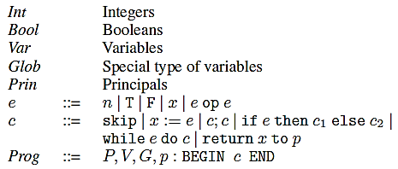
Language Syntax
Principal to which a value is to be returned is explicitly mentioned – crucial for implicit downgrading
System resources and other Globals used in the computation
Stakeholders of the computation
Variables in the computation
Authority of the computation
The computation

Slide 64
Defining Information Misuse
(MISUSE) A program is said to MISUSE information, if there exists a command at a point ‘i’ in the program which when executed causes an information flow that is not a permissible flow at that program point, i.e., violates the underlying can-flow-to lattice λ_{i}
(SAFE) A program is said to be SAFE if it does not misuse information at any point in the program

Slide 65
Notations and Assumptions
‘S’ denotes the set of all the principals
A special variable called ‘pc’ (program counter) depicts the current stage of the computation
Evaluation context is defined by tuple [M, λ]
M denotes memory contents
λ denotes the labelling
Functions A, R and W return the first (admin), second (readers) and third (writers) components of a label respectively

Slide 66
Notations (1)
Constants (integers, Booleans) are immutably labelled (−, S, {})
Globals (files and other system resources) are mostly statically labelled (with the exception of possible downgrading for returning)
initial labels are provided by the underlying environment as per the application requirements
All other variables are dynamically labelled
labels are automatically computed at every stage of the computation
Language-based security literature, in contrast, considers all the variables to be statically labelled with the burden of providing labels left to the programmer

Slide 67
Notations (2)
Following functions are available, F : c → 2^{Var}
VA variables
NG non-global variables
MV modified variables
MG modified globals
MNG modified non-globals
AG accessed globals

Slide 68
Deriving a Labelled Program for Interpreting Information Misuse
We define a semantic mapping for deriving a security labelled program for a given program

Slide 69
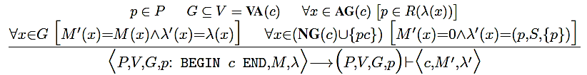
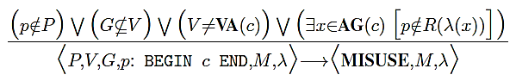
The environment of program execution
Non-globals including the pc are initialized to 0, and assigned a label indicating:
p is the owner and the only influencer, and all the subjects are permissible readers
Globals are a subset of the variables
Program authority is a stakeholder in the computation
Variables are correctly provided
Program authority is a valid reader of all the globals the computation uses
Values and labels of globals are unchanged
c is evaluated further in the environment (P,V,G,p) and execution context [M’,λ’]
If any of the conditions fail, the program is declared to MISUSE information

Slide 70
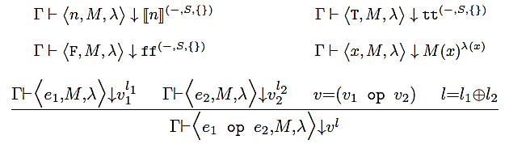
Semantics of Expressions
v^{l} denotes a value v with label l
↓ denotes “evaluates to”
e₁ evaluates to v₁ with label l₁
e₂ evaluates to v₂ with label l₂
v is v₁ op v₂
l is LUB(l₁, l₂)
e₁ op e₂ evaluates to v with label l

Slide 71
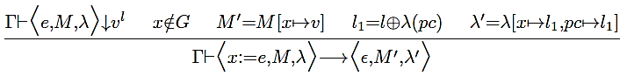
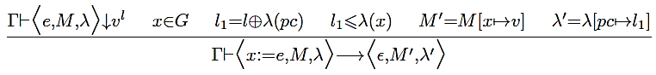
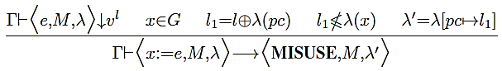
Semantics of Assignment
Interpretation of “x:=e”: program reads the value being assigned and writes it to the variable being assigned
Assignment to non-globals always succeeds
By appropriately modifying the label of the variable and the pc
Assignment to globals succeeds only when
By appropriately modifying the label of the pc
Both the value being assigned and the pc can-flow-to the global
When either the value being assigned or the pc cannot flow to the global being assigned, the assignment is declared to MISUSE information
Note that even in this case the label of the pc is modified to reflect the stage of the computation correctly

Slide 72
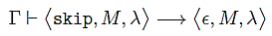
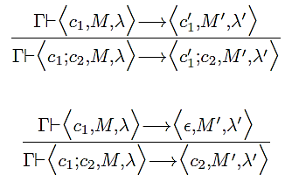
Semantics of skip and sequential composition

Slide 73
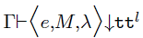
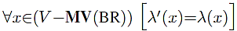
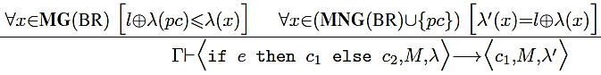
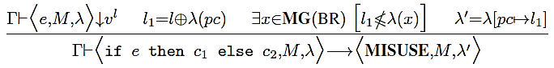
Semantics of branching (if-then-else)
Interpretation of the conditional statement (BR): causes information flow from the condition to both the branches, irrespective of which branch gets executed
The labels of both the condition and the pc can-flow-to globals that may be modified in either branch
The labels of non-globals that may be modified in either branch are updated by the label of the condition
If either the label of the condition or the pc cannot-flow-to a global that may be modified in either branch, the program is declared to MISUSE information, irrespective of whether that branch will be taken or not

Slide 74
NOTE: in the traditional program certification approach due to Denning & Denning, e≤S₁⊗S₂ is verified for the program “if e then S₁ else S₂”
Because of the dynamic labelling used in our approach, updated labels of variables in both the branches satisfy e≤x (because e↓v^{l} and λ’(x)= λ(x)⊕l)
Let x_{ij} be a modified variable in S_{i} for i=1 and 2
The following is a trivial consequence of the definition of ⊗
(∀i,j e≤x_{ij}) if-and-only-if e≤ ⊗ x_{ij} = S₁⊗S₂

Slide 75
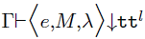
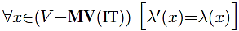
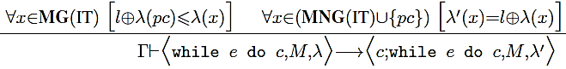
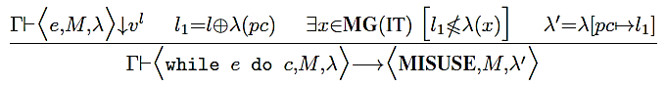
Semantics of iteration (while)
Interpretation of the iteration statement (IT): causes information flow from the condition to the body, irrespective of whether the body ever gets executed
The labels of non-globals that may be modified in the body are updated by the label of the condition
The labels of both the condition and the pc can-flow-to globals that may be modified in the body
If either the label of the condition or the pc cannot-flow-to a global that may be modified in the body, the program is declared to MISUSE information, irrespective of whether the body will get executed or not

Slide 76
The return statement
From our experiences with information flow control so far, downgrading seems to be needed only for sharing the results of a computation with other stakeholders of the computation
the computations of the stakeholder itself must continue with the sensitive label, without which there is a possibility of information misuse
return command in our language is to facilitate meaningful interactions amongst the stakeholders of a computation while prohibiting information misuse

Slide 77
Downgrading
For practical applications, adding readers (downgrading) to the result of a computation is essential for use by relevant parties
Downgrading rules
only the owner of information may downgrade it
if a single source is responsible for the information, then readers that can be added is unrestricted
if multiple sources influenced the information, then only those who influenced it may be added as readers

Slide 78
Advantages of our approach
Most approaches in the literature use syntactic lattices, and as a result struggle to identify the appropriate level to which the data is to be downgraded, and end up downgrading it to the bottom label
(VS)
In our approach, we only need to add the principal named in the return statement as a reader - thus providing a very fine definition of downgrading

Slide 79
Advantages (1)
Most approaches in the literature provide explicit program constructs for declassify and endorse, thereby opening up the possibility of their malicious use
(VS)
We overcome several problems associated with downgrading in the literature by handling downgrading implicitly through the return command, which is explicitly specified

Slide 80
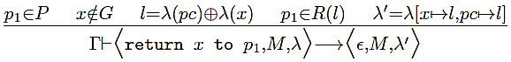
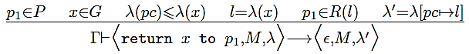
Semantics of return – simple case
Interpretation of the return statement “return x to p₁” is flow of information from p to p₁
p₁ is a stakeholder in the computation, and is a valid reader of both the variable x and the pc

Slide 81
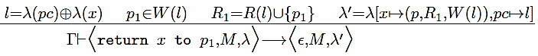
Semantics of return – downgrading
OR
If either p is the sole influencer of the variable and pc, or p is the owner and p₁ is an influencer of the variable and pc, then p₁ may be added as a reader of the variable
OR

Slide 82
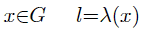
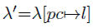
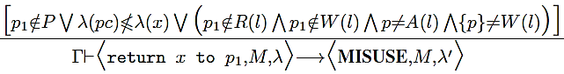
Semantics of return – misuse
If all the conditions fail, then it is unsafe for the value to be returned to p₁, and would be declared as MISUSE

Slide 83
Observability and Influence
Labels of objects also provide access checks:
at a program point with labelling λ, principal p will be allowed to observe a variable x only if p ∈ R(λ(x)) holds
at a program point with labelling λ, principal p is said to have influenced a variable x only if p ∈ W(λ(x)) holds
properties like termination, progress, duration of execution etc. can be easily secured by enforcing the above rule on the label of pc

Slide 84
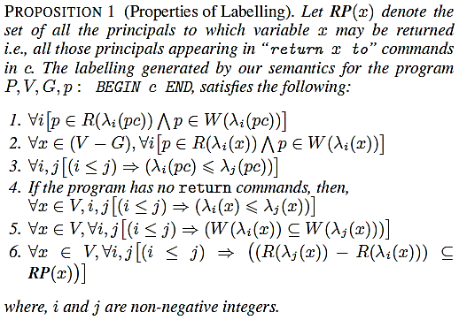
Properties of Labelling

Slide 85
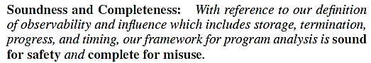
Soundness and Completeness

Slide 86
Illustrative Examples
Information misuse detection using RWFM

Slide 87
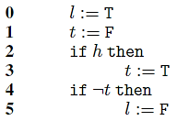
Example - 1
Benchmark program for evaluating soundness of flow-sensitive dynamic labelling analysis
The challenge is to track the indirect information flow from h to l
l must be labelled sensitive when h is sensitive

Slide 88
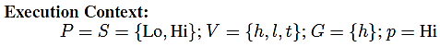
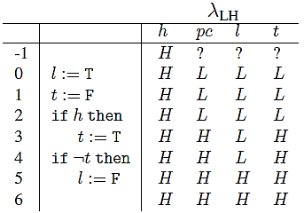
Analysis – two-point lattice

Slide 89
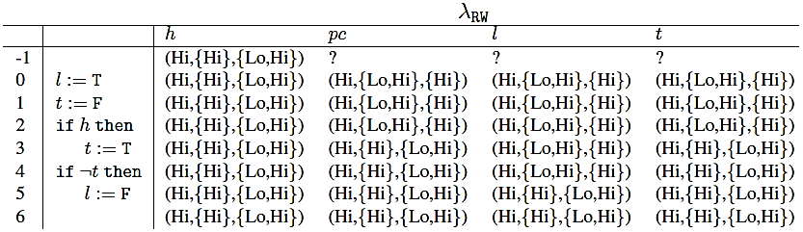
Analysis – RWFM

Slide 90
Summary
Since Lo∉R(λ₆(l)), Lo will not be allowed to observe the value of l at point 6
our analysis correctly marked the flow of information from h to l, irrespective of whether the assignments at points 3, 5 were executed or not
Similarly, Lo will not be allowed to observe the value of t or the status of the program - like termination, execution time, resource usage etc. - beyond point 2
RWFM analysis more finer-grained than analysis using the two-point syntactic lattice
distinctions become more clear in non-trivial lattices

Slide 91
Example - 2
Password update program
v₁, v₂ and v₃ denote password, guess and new password respectively,
C denotes the client whose password is to be updated, and
L denotes the system admin responsible for updating the password

Slide 92
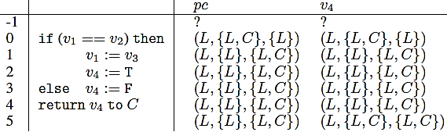
Analysis – RWFM
λ(v₁) =
λ(v₂) = λ(v₃) =
Downgraded

Slide 93
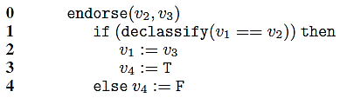
Analysis – DIFC

Slide 94
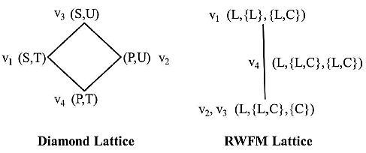
Comparison – RWFM vs DIFC
Note that the flows v₂ to v₁, v₂ to v₄ and v₃ to v₁ seem natural and easier to visualize in the RWFM lattice
Impossible in the diamond lattice without declassify and endorse !! True not only in this example, but in the general case as well

Slide 95
Drawbacks of the diamond lattice approach
Under the reasonable assumption that attackers are assigned label (P,U), and trusted subjects are assigned label (S,T), no non-trivial secure computation is possible without endorsing attackers inputs and declassifying the secure outputs
having declassify and endorse as explicit language constructs opens up a lot of covert channels which are impossible to overcome

Slide 96
Example - 3
Scheduling a meeting time
Mutually distrusting parties Alice (denoted by p₁) and Bob (denoted by p₂) wish to schedule a joint meeting using a third party scheduler denoted p₃
Alice and Bob’s calendars are denoted by c_{a} and c_{b} labelled (p₁, {p₁, p₃}, {p₁}) and (p₂, {p₂, p₃}, {p₂}) respectively

Slide 97
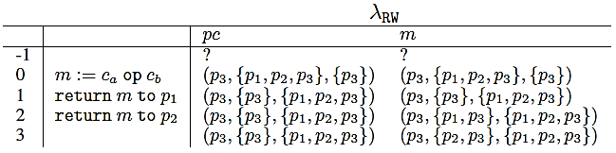
Analysis – RWFM labels
Meeting time downgraded to return to p₁
Meeting time downgraded to return to p₂

Slide 98
RWFM vs Laminar
For achieving the same functionality and same security, Laminar uses special program constructs like security regions, explicit declassification and endorsement
difficult to write secure programs to achieve the desired results; to the contrary, it is easy for an attacker to abuse these features
further, the programmer also has the burden of explicitly annotating all the program variables

Slide 99
RWFM vs Laminar (1)
For the same example (conference version), the meeting time computed by the server would have the label ⟨S(a, b), I()⟩ which means that it has secrecy tags a and b
inaccessible to both Alice and Bob
cannot be declassified by either of them
only way is to provide capabilities a⁻ and b⁻ to the scheduler ⇒ he can leak the calendars of Alice and Bob by declassifying them, if he so chooses !!
Note that the journal version does not contain these problems - except that in this case Alice would be forced to share his calendar with Bob !!

Slide 100
Summary
Dynamic labelling of programs using the RWFM model provides a sound labelling scheme that enables the detection of misuse of information w.r.t confidentiality/integrity of the program
The labelling is constructive ⇒ enables the programmer to assure the security of specifications w.r.t the specified environment
First work that provides a sound approach for a general lattice, and enables a blending of MAC (IFC) and DAC (controlled downgrading)

Slide 101
Language Based Security via
Constraint Generators

Slide 102
Achievements of RWFM in general
Principle of Full Information (Woo and Lam)
in every outgoing message, participants must include all of the information they have gathered so far in the exchange
Principle1 of Abadi and Needham
every message should say what it means: the interpretation of the message should depend only on its content

Slide 103
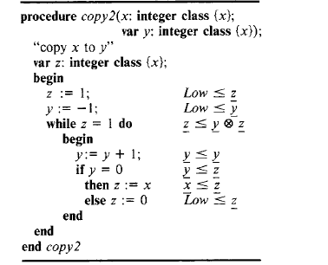

Slide 104
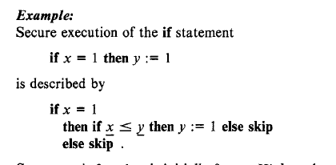

Slide 105
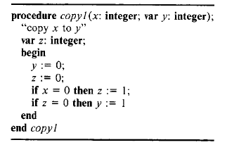
If X < y is not tested, it will be insecure

Slide 106
Non-Interference of Type Systems
A program p does not leak information if, for all possible start states S1 and S2 such that S1 is identical S2 when projected on low , whenever executing p in S1 terminates and results in S1’ and executing p in S2 terminates and results in S2’ , then S1’ and S2’ are congruent on low .
Similarly for Integrity --- Equivalence needs to be defined.
Termination –sensitive non-interference: as above with the addition “it terminates”
Generalized forms of Non-interference for concurrent systems ( Naren and RKS 2017)

Slide 107
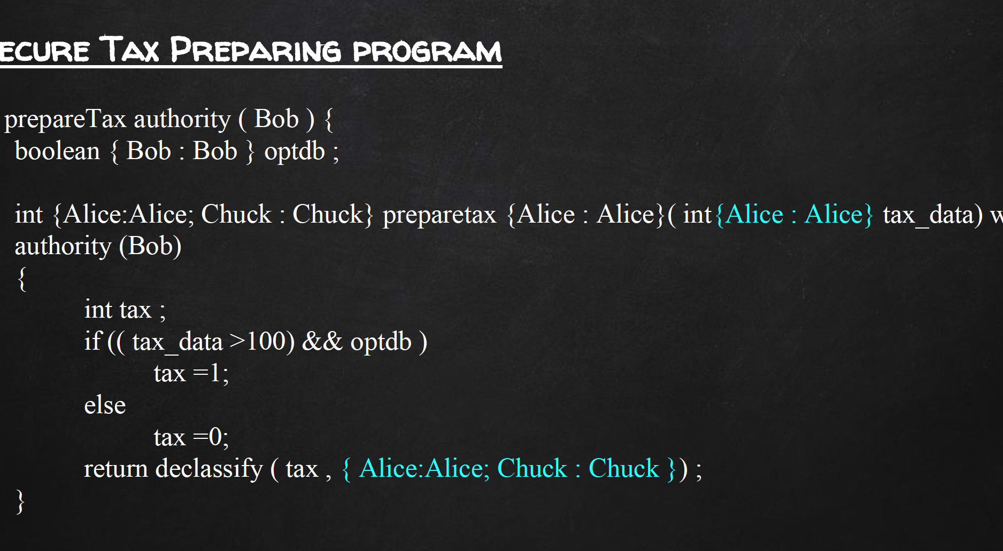
Tax Example using JIF

Slide 108
RWFM achievements in general
Canonical Intensional Specification (Roscoe)
no participant can believe a protocol run has completed unless a correct series of messages has occurred up to and including the last message the given participant communicates
Abadi advocates
specification should say how principals check the messages they receive, before responding to them

Slide 109
Conclusions
A novel security model that enables decentralized IFC that maintains MAC wrt DAC.
The model is complete wrt Denning’s Model and enables generation of labels automatically
Currently, building a full fledge Operating System that is provable IFC secure (establishing properties like isolation, noninterference, confidentiality, integrity, availability and accountability )

Slide 110
Conclusions: Potential
Building protocol specification language for assuring protocol (including crypto) workflows
Establishing possible web attacks in protocols with the given threat model
Compliance of security policies for health information networks
Establishing formally privacy requirements based on purpose.
Checking policy (privacy) compliance of social networks and their affiliates.

